Slide 1
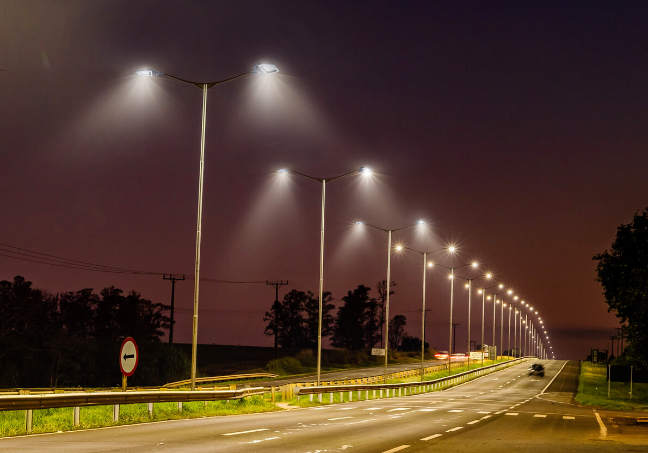
Smart Streetlighting
Project Presentation
CS667A: Introduction to IOT
BY
Deepak Mathur (22111019)
Ashee Jain (22111073)
Srujana Sabbani (22111083)
Atanu Kar (22111086)
Anjali Monaj (22111262)

Slide 2
Table of Contents
Literature review
Proposed model
Sensors
Data flow and WSN
Connection
Fault detection
Bill of Materials
Milestone
References

Slide 3
Literature review
H C Lee at el. :[3] A low-cost and noninvasive system for the measurement and detection of faulty streetlights
Used HitchHiker device for fault detection.
Imaps(Illumination maps) are created to get the approx. location of the fault.
Advantages
Extra infrastructure cost not required
Easy to deploy
Disadvantages
Cannot exactly determine if there is a fault.
Several hours delay in fault detection
It is not an effective way to detect fault on a large scale.
The illumination reading from the light sensor may be incorrect due to different weather conditions (such as rain or fog) or dirt on the light sensor.

Slide 4
P. Karthikeyan at el. :[4] Design and Implementation of Smart Street Light Automation and Fault Detection System
Creation of Wireless Sensor Network of streetlights.
The components employed include ESP32 development board, Power Converter module, Real Time Clock, LDR, GPS module.
It can collect the street light’s working status in real time.
The Real Time Clock (RTC) present in the ESP 32S development board is used to get the real time data which is used to switch the lights ON/OFF and identify the faulty lights.
If the real time is between 6:00 PM - 06:00 AM and also if the environmental LDR senses the absence of light, then the light is kept in ON position.
The failure of the above condition is considered as a fault.
Advantages
Exact location of the faulty streetlight can be obtained with the help of GPS module.
Real time fault detection.
Disadvantages
Each streetlight will have all the mentioned components, hence it is not cost efficient.
The cost of modifying conventional streetlights is so high that it is nearly impossible to realize this system in the short-term.

Slide 5
S. Sophiya Susan at el. :[9] Vehicle Movement based Innovative Smart Highway Lighting System
Aim: To create a dynamically programed motion detecting automatic street lighting system with the main focus on scalability. The streetlights’ energy consumption is reduced by toggling the lights on and off based on the presence of movement of vehicles or pedestrians along the highway
Sensor input : an array of sensor nodes that provide information on the movement in their immediate surroundings. This information and the node ID is broadcasted by radio waves to their immediate neighbors
Methodology :
When a sensor detects motion, it broadcasts this information and its ID
Sensors in the node array use NRF24L01 which has a better range of 100m and easier to integrate
By default, receiver. Upon receiving information, transmits radio waves to immediate two neighbours.
System identifies continuous movements and stationary objects by comparing the array elements and prevents toggling.
In case of faulty nodes, the module is surpassed by providing direct supply of power from the source, making it “ON”

Slide 6
Advantages :
Reduces the energy consumption of streetlights by toggling lights on and off based on movements along the road.
Logical computations are performed by the automation system along the active sensor nodes - no requirement for a central logical unit.
The proposed model has a synchronized array of nodes that is able to accept new nodes without requiring any changes to the existing nodes, thus allowing to increase the size of the automation-network swiftly.
Proper solution in case of faulty nodes
Disadvantages:
Expensive to be deployed in real life.
There is a requirement of apt and fast lighting of the streetlights in cases when vehicles at high speed approach fast.
Constant attention to the working of sensors and each of its nodes are required as there is not central node or server which controls the network. Every node has its own sensor and works on tis own.

Slide 7
A. Abdullah at el. :[10] Smart Street Light Using Intensity Controller
Aim: Proposing a smart streetlight system using sensors which optimises motion detection and reduces the power consumption along with it.
Three main components - LED lamps, controlled sensors and object movement.
Methodology:
Light Dependent Resistor (LDR) acts as a sensor that can adjust the light intensity – if less than 80% of sunlight is detect, light turns on.
Two Infrared (IR) sensors used to detect the speed of moving object – time taken is calculated when the object reaches each of the sensors, the distance is known to be 6cm and the speed is calculated hence.
Intensity of light emitted finally based on the resultant speed calculated – Low intensity (30%), Medium intensity (70%), High intensity (100%)
Hence LDR detects light intensity and IR detects motion.

Slide 8
Advantages
Very efficient in terms of detecting the light requirement during day and night, as well as based on motion of vehicles or pedestrians
Uses LED instead of conventional metal halide bulbs, making it power efficient as well.
Results proved it can save up to 40-40% energy for a month
Disadvantages
Hard to deploy in real life everywhere as it uses LDR as well as two extra IR sensors.

Slide 9
C. -W. Yang at el. :[1] Vehicle and pedestrian aware street lighting automation
Comparison
Vehicle and pedestrian aware street lighting automation | Our model
In this paper they are using some rules for the motion of vehicles that are: If V_{vi}<V_{max} Then V_{vi} = V_{vi}+1 IF V_{vi}<g_{vi} THEN V_{vi}= g_{vi} IF V_{vi}>0 AND V=1 THEN V_{vi}=V_{vi}-1 where V_{vi} is vehicle velocity of vehicle i, g_{vi} is the number of cells between vehicle i and the vehicle going ahead. V is a variable with random value either 0, or 1, and is needed as an uncertainty parameter. | In our model we are not using any such constraints controlling the vehicle speed.

Slide 10
Features | Our work | Advanced Adaptive Street Lighting Systems for Smart Cities[7] | Multihop Gateway-to-Gateway Communication Protocol for LoRa Networks[8] | Routing in LoRa for smart cities: A gossip study
Sensor Node to gateway communication | LoRa | Zigbee | LoRa | LoRa (Implementation of LoRaWAN with single Relay Node)
Gateway to Gateway Communication | LoRa (Locations w/o Ethernet connectivity), Ethernet connectivity | 3G/4G connectivity | LoRa | Out of Scope
Gateway to server connectivity | Ethernet Based Public Internet connectivity | 3G/4G Connectivity | LoRa | Out of scope

Slide 11
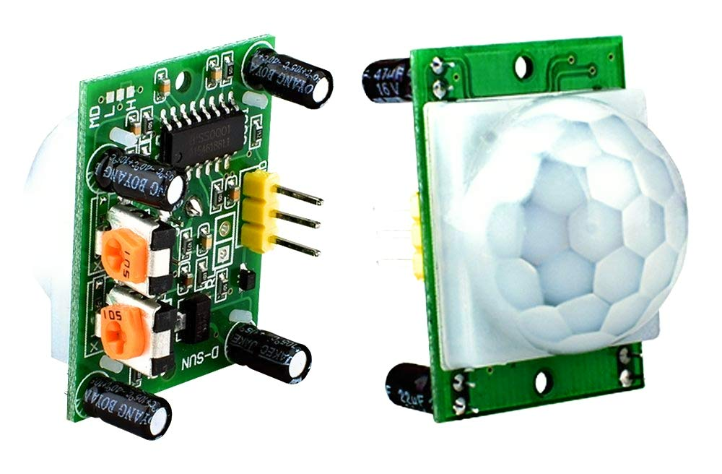
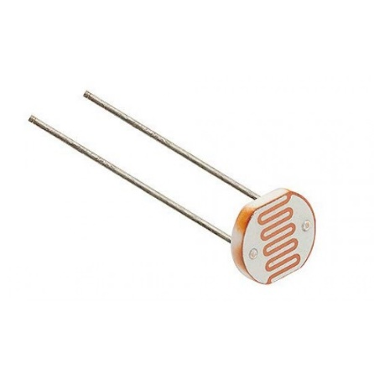
Proposed model
SENSORS
1. Passive Infrared Sensor (PIR)
In this smart street light system PIR is used to sense the motion of the human or vehicle within a defined distance range by the amount of infrared light emitted from the objects. PIR sensors have ranges of up to 10 meters (30 feet).
2. Light Dependent Resistor (LDR)
LDRs are very important in dark/light sensor circuits, as they aid in the automatic on/off of street lights. LDR senses the lighting in the environment, measures the amount of light and based on the measurement obtained.`
PIR
LDR

Slide 12

Data flow and WSN
Need Answers …
What will be the network architecture for data flow and control of street lighting
What would be the Network Topology in the WSN
What Routing protocol is best suited for this application
What communication protocol will be established for Intra Cluster and Inter Cluster Communication

Slide 13
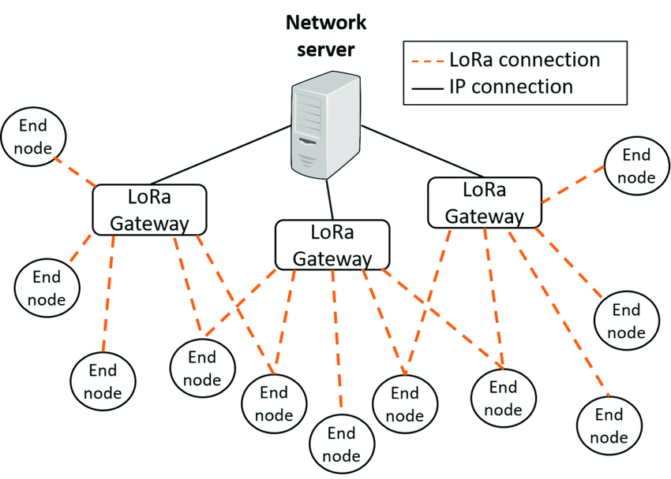
Network Design
Hierarchical Network Architecture - Two Level Hierarchy
Network Topology - Star-Mesh Hybrid Topology
Higher level: Mesh Topology
Low Level consists of End Devices with sensor nodes and LoRa Gateway as Cluster Head or an Aggregator : Star Connectivity with LoRa gateway at the centre- Communication over LoRa Protocol
Higher Level will consists of LoRa Gateways and a Network server/ Application Server running decision making algorithms : Mesh connectivity between gateways and server - Communication Over Wi-fi or Ethernet.
End Node :
ESP32 LoRa 32 (V2) with 868/915 MHz with motion detection sensor
LoRa gateway :
Single Channel /Multi channel LoRa Gateway
Lower level: Star Topology (LoRa)

Slide 14
Communication and Data Flow Model
Communication Protocol - Intra Cluster: LoRa
- Inter Cluster: Ethernet / Wi-Fi
LoRa protocol addresses scalability in the smart grid
Mesh Topology in the higher level ensures Fault tolerance in the network
Multi-hop mesh network routing is proposed
Multi-hop routing helps achieving fault tolerance in WSN
Network/ Gateway status monitoring of Ethernet based IP Network at higher level
Monitoring of End Device/Sensor Node status through web access of LoRa gateway
Sensors
End Device
Gateway
Server Node

Slide 15
Connection
Set of streetlights(say 3)
S
E
R
V
E
R
Sensor
End device (Raspberry PI)
Gateway
G1
E1
E2
E3
S1
L0
S2
L1
S3
L2
S4
L3
S5
L4
S6
L5
S7
L6
S8
L7
Flood
light
Sensor Si is responsible for controlling Li.
At the start of road a sensor Si controls Li-1 and Li.
At the crossing the end sensors are responsible for controlling central light.
End device Ei gets data from nearest 3 sensors.
Gateway Gi gets data from nearest 3-5 end devices.
Distance between two streetlight is 70m.
Distance covered with one gateway approximately 2Km.

Slide 16
Key Areas
1. Target area : NH/SH with less traffic during night, Highways to remote locations
2. Our work aims at implementing a low cost solution for smart streetlighting by using the existing traditional streetlamps.
3. Our work is scalable in terms of adding additional control systems like installing Camera, GPS etc.

Slide 17
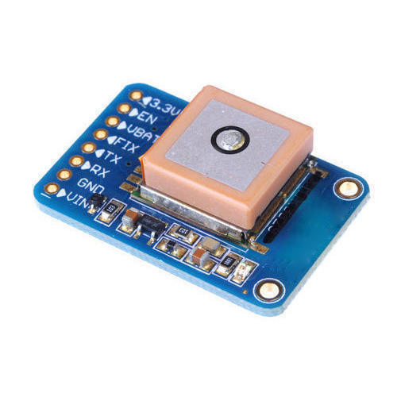
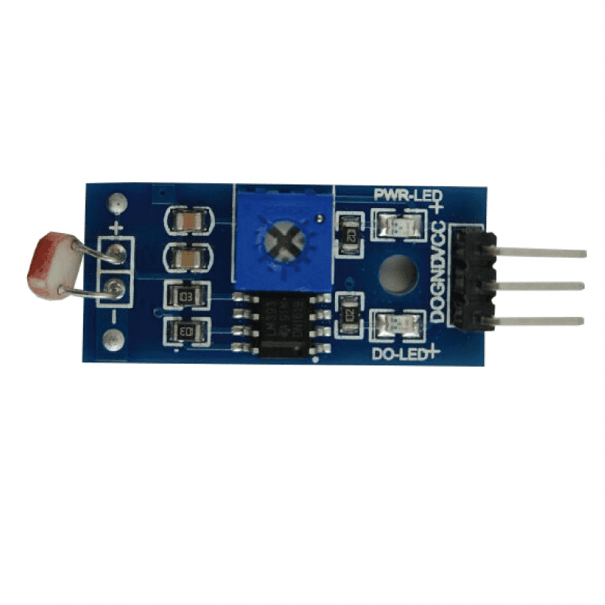
Fault Detection
An ambient light sensor(LDR) is a photodetector that is used to sense the amount of ambient light present, and appropriately dim the device's screen to match it.
One IoT board will control 3-5 streetlights and the board will be equipped with GPS module.
We use two light sensors one( say A) to check whether it is day or night and another(say B) placed just below the streetlight to check whether it is on or off.
If it is night and PIR sensor detects an object in the road but sensor B doesn’t get light from streetlight it means the streetlight is faulty.
LDR
GPS Module

Slide 18
Bill of Materials
S.N. | Components | Description | Quantity
1 | LEDs |  | 18-24
2 | PIR sensor |  | 9-12
3 | LDR sensor |  | 18-24
4 | Dimmers |  | 9-12
6 | GPS module |  | 3-4
7 | LoRa end device | Arduino MKR WAN 1300 with LoRa module. | 3-4
8 | LoRa Gateway | Arduino Pro LoRa Gateway development kit | 2

Slide 19
Milestone
Phase | Activity | Date of completion
1 | Integration of sensors with IOT development board | 25-Oct-22
2 | Establishment of WSN, Gateway and server connectivity | 1-Nov-22
3 | Fault tolerance, monitoring and accessing of gateways/sensor nodes | 10-Nov-22
4 | Write-up | 14-Nov-22

Slide 20
References
C. -W. Yang, E. Nefedov, S. Sierla and P. Flikkema, "Vehicle and pedestrian aware street lighting automation," 2015 IEEE 13th International Conference on Industrial Informatics (INDIN), 2015, pp. 1269-1274, doi: 10.1109/INDIN.2015.7281917.
Nefedov, Evgeny, et al. "Energy efficient traffic-based street lighting automation." 2014 IEEE 23rd International Symposium on Industrial Electronics (ISIE). IEEE, 2014.
H. -C. Lee and H. -B. Huang, "A Low-Cost and Noninvasive System for the Measurement and Detection of Faulty Streetlights," in IEEE Transactions on Instrumentation and Measurement, vol. 64, no. 4, pp. 1019-1031, April 2015, doi: 10.1109/TIM.2014.2361551.
P. Karthikeyan, M. Karthik, V. Deepikapriya, S. Divya Briya, R. Dharanishwarma and S. Janakirthick, "Design and Implementation of Smart Street Light Automation and Fault Detection System," 2022 2nd International Conference on Power Electronics & IoT Applications in Renewable Energy and its Control (PARC), 2022, pp. 1-7, doi: 10.1109/PARC52418.2022.9726622.
Jabbar, HN Jasim ZN Kamal SF. "SMART COMMUNITY WITH CREATE A MANAGEMENT SYSTEM FOR STREET LIGHTS.“
Fanoon, A. R. F. S., and A. R. F. Shafana. "Smart lighting system for efficient street lighting." J. Technol. Value Addition 1.2 (2030): 36-47.

Slide 21
Gagliardi, Gianfranco, et al. "Advanced adaptive street lighting systems for smart cities." Smart Cities 3.4 (2020): 1495-1512.
Dwijaksara, Made Harta, Wha Sook Jeon, and Dong Geun Jeong. "Multihop gateway-to-gateway communication protocol for lora networks." 2019 IEEE International Conference on Industrial Technology (ICIT). IEEE, 2019.
S. Sophiya Susan, A. Praveen Raj, A. Mishra and V. Thambi, "Vehicle Movement based Innovative Smart Highway Lighting System," 2022 International Conference on Inventive Computation Technologies (ICICT), 2022, pp. 483-488, doi: 10.1109/ICICT54344.2022.9850478.
A. Abdullah, S. H. Yusoff, S. A. Zaini, N. S. Midi and S. Y. Mohamad, "Smart Street Light Using Intensity Controller," 2018 7th International Conference on Computer and Communication Engineering (ICCCE), 2018, pp. 1-5, doi: 10.1109/ICCCE.2018.8539321.

